Slide 1

Secure and Ethical Monitoring System for Keystroke and User Behavior
CVR COLLEGE OF ENGINEERING
Vastunagar, Mangalpalli (V), Ibrahimpatnam (M), R.R. District
Batch No: 3 Major Project Review - 3
Presented by: Supervised By:
S. Pavan Kumar (21B81A6227) Mrs. G. Sunitha Rekha
G. Pranay (21B81A6230) Sr. Assistant Professor
R. Sai Uttej (21B81A6245) Department of CSE(CS)

Slide 2
DOMAIN INTRODUCTION
In today's digital landscape, cybersecurity and ethical monitoring are crucial for safeguarding sensitive information and preventing unauthorized activities. Our project focuses on developing a secure and ethical keylogging system that ensures responsible monitoring while complying with privacy laws and ethical standards.
This system is designed to capture keystrokes, clipboard data, and screenshots, allowing for real-time detection of unauthorized or suspicious activities. It plays a critical role in forensic analysis, parental control, and enterprise security monitoring, providing administrators with valuable insights to detect threats, prevent data breaches, and ensure compliance.
To enhance security, the system integrates advanced data encryption for secure storage and transmission of captured logs. Additionally, an automated alert mechanism notifies administrators whenever blacklisted words or suspicious activity is detected, ensuring proactive threat mitigation.
With potential applications in corporate cybersecurity, child safety, and insider threat detection, this project sets a new standard for intelligent, privacy-compliant, and security-focused monitoring solutions.

Slide 3
CHALLENGES & PROBLEM STATEMENT
Challenges
Privacy and Security Risks: Capturing sensitive keystrokes and screenshots may lead to data breaches if not properly encrypted and secured.
High Computational Overhead: Real-time fuzzy word detection, encryption, and alert mechanisms require optimized processing to avoid system lag.
Problem Statement
Tamper-Proof Keylogging: Ensuring captured keystrokes and activity logs cannot be altered after being stored in the database.
Encrypted Data Storage: Securely storing all logs using encryption techniques (AES, RSA, etc.) to prevent unauthorized access.
Automated Threat Detection: Implementing fuzzy word detection to identify blacklisted terms and immediately trigger alerts.
Screenshot-Based Evidence: Capturing screenshots whenever suspicious words are detected for forensic analysis.
Admin Alert System: Automatically sending email alerts to administrators in case of security violations.
User Activity Visualization: Providing an interactive dashboard with filters, word frequency analytics, and keylog summaries.

Slide 4
EXISTING METHODOLOGIES
Hardware Keyloggers
Hardware keyloggers are physical devices placed between the keyboard and computer. They intercept keystrokes at the hardware level, storing them internally. Some advanced models may even send data wirelessly, though most rely on internal storage that must be manually retrieved.
Software Keyloggers
Software keyloggers are applications installed on a computer to log keystrokes. They capture input directly from the system or application, recording keystrokes and possibly other data such as screenshots or clipboard contents.
Remote Keyloggers
Remote keyloggers are specialized software keyloggers that transmit captured data over the internet to a remote server or device. They are often used in scenarios where continuous, real-time monitoring is necessary, and physical access to the target system is impractical.

Slide 5
LITERATURE SURVEY
Title | Author | Year | Limitations
Privacy Implications of Keylogging in Modern Systems | Zhang, H. & Liu, S. | 2021 | Potential misuse and privacy concerns
Balancing Security and Privacy in Keylogging | Bhardwaj, N. | 2022 | Ethical issues in workplace surveillance
Keylogging in Python: Using the Pynput Library | Kumar, A. & Gupta, P. | 2021 | Limited to software-based keylogging
Keyboard Event Capturing with Python and Pynput | Smith, R. & Allen, K. | 2022 | No built-in security mechanisms
The Ethics of Keylogging in Cybersecurity | Robinson, G. | 2019 | Potential for abuse without strict regulations

Slide 6
PROPOSED SOLUTION
Keylogging: Records keystrokes along with timestamps and securely logs them in the database.
Secure Data Transmission: Stores and transmits encrypted data to ensure security over the network.
Multi-User Monitoring: Allows administrators to monitor multiple users within the same local network.
Screenshot Capture: Captures screen snapshots upon specific triggers, preserving visual evidence.
Email Reporting: Automatically sends keylogging data and captured screenshots via email for remote access and review.

Slide 7
TECHNOLOGY STACK USED
Frontend:
React: For building a dynamic and responsive user interface.
TypeScript: Ensures better type safety and maintainability.
Bootstrap: Provides a clean and user-friendly UI design.
Backend:
Flask: Lightweight Python web framework for handling API requests.
Python: Core language used for backend logic and keylogging.
MongoDB: NoSQL database for securely storing monitored data.
Pynput: Captures keystrokes and input events.
Security:
Data Encryption: Protects stored and transmitted data.
Alert Mechanisms: Notifies parents of suspicious activity.
Networking & API Communication:
Axios: Handles frontend-backend communication efficiently.

Slide 8
MODULE STRUCTURE
Keylogging Module: Captures keystrokes and logs activity.
Clipboard & Screenshot Module: Records clipboard data and screenshots.
Alerting Module: Sends automated email alerts for unethical behavior.
Data Encryption Module: Secures stored data.
Parental Control Dashboard: Provides monitoring tools.

Slide 9
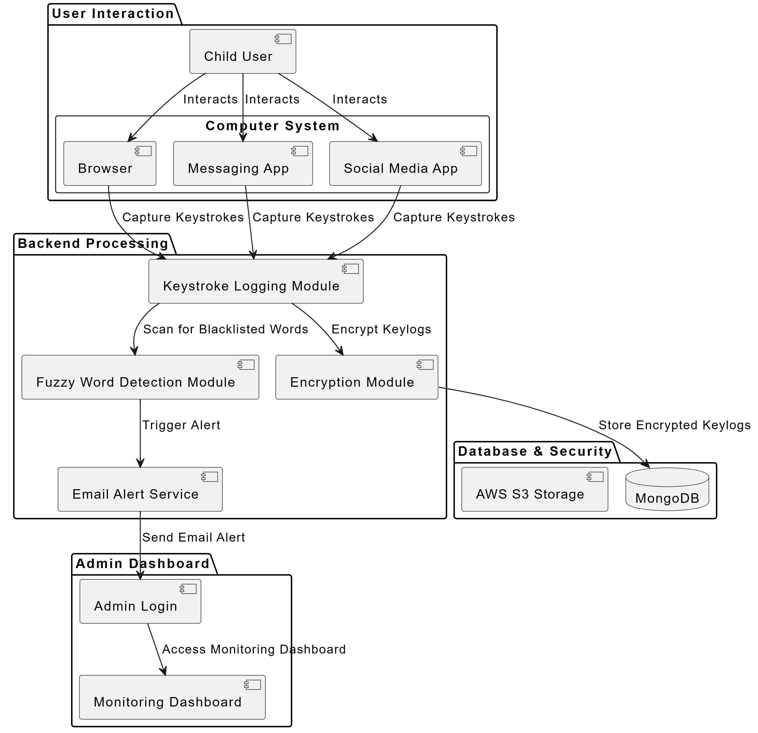
System Architecture

Slide 10
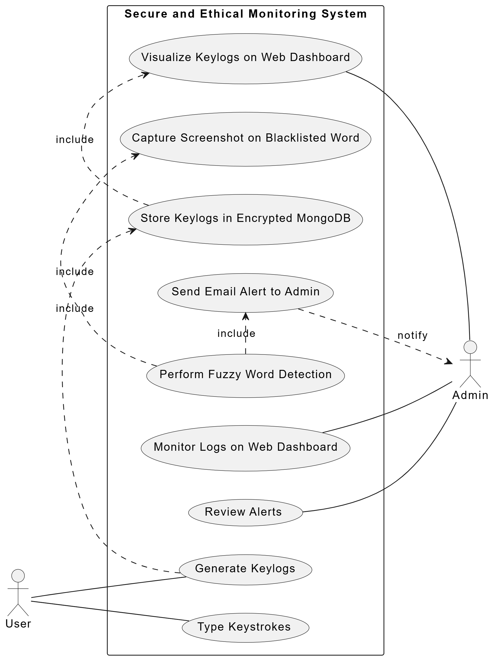
Usecase Diagram

Slide 11
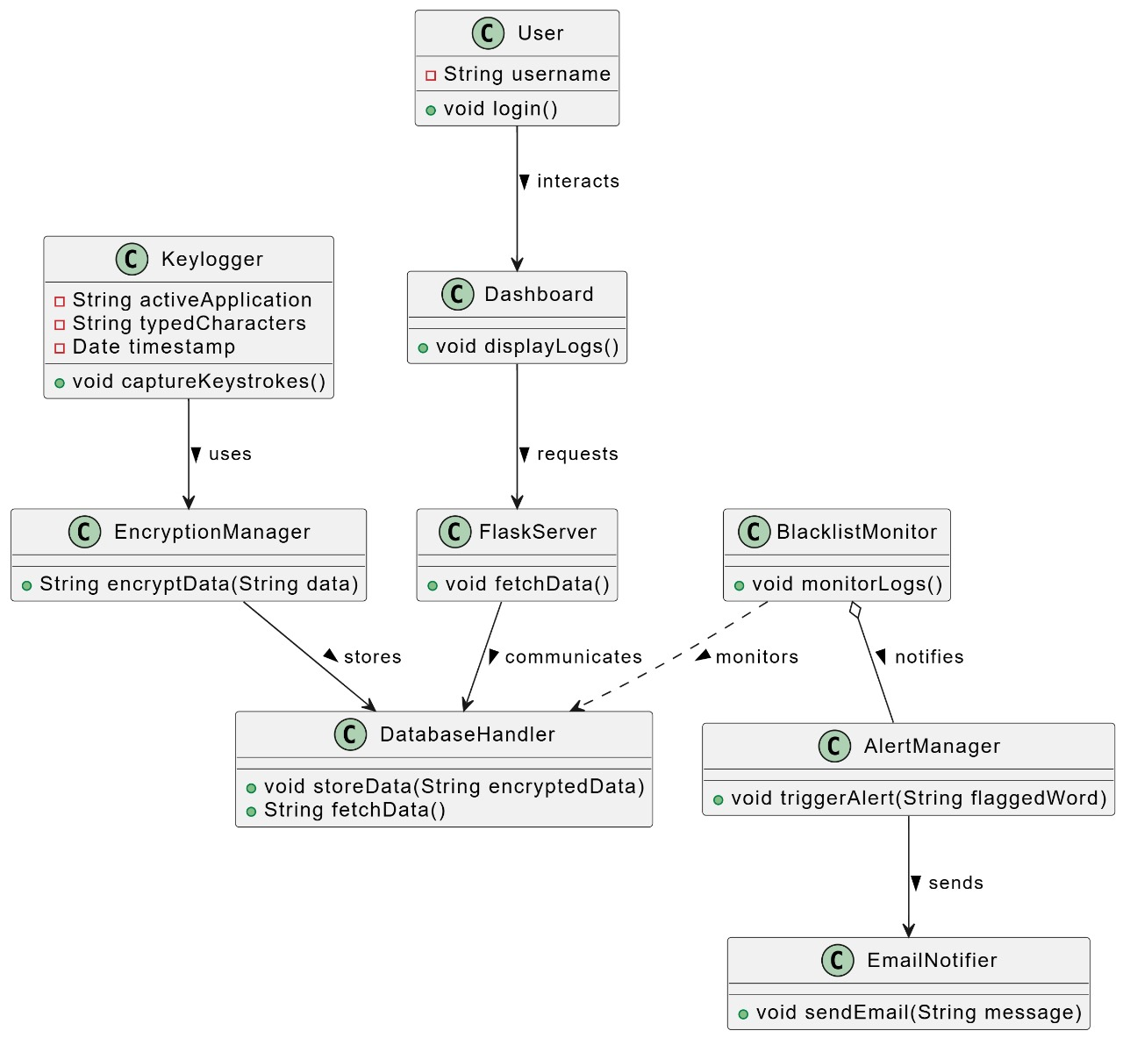
Class Diagram

Slide 12
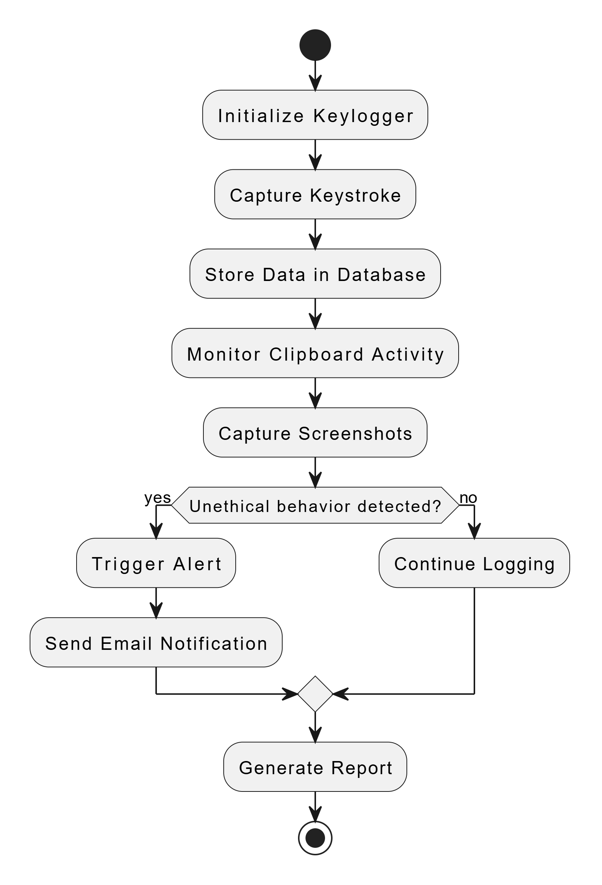
Activity Diagram

Slide 13
SAI UTTEJ’S CONTRIBUTION
Role : Backend design and development.
Contributions:
Developed Keylogging System
Implemented keystroke capture using pynput.
Designed buffered logging to optimize performance.
Integrated clipboard monitoring and screenshot capturing.
Database Integration & Batch Processing
Configured MongoDB for keylog storage.
Designed an efficient batch insert mechanism for logs.
Developed the database writer thread to handle queue processing.

Slide 14
PAVAN’S CONTRIBUTIONS
Role : Frontend design and functionality.
Contributions:
Flask API (app.py) Development
Created API endpoints for retrieving keylog data.
Implemented date-based filtering for fetching logs efficiently.
Developed word frequency analysis & word cloud generation.
Frontend Development (React)
Integrated Flask API with React frontend using Axios.

Slide 15
PRANAY’S CONTRIBUTION
Role : Security & Alert System development
Contributions:
Security & Encryption Mechanisms
Integrated secure storage & retrieval of logs.
Ensured encryption of sensitive keystrokes.
Alert & Notification System Implemented real-time alerts for unethical behavior detection.
Designed automatic email notifications on detecting suspicious activity.

Slide 16
Conclusion & Futher Enhancements
1. Implementing Natural Language Processing (NLP) for Advanced Analysis
Integrate NLP models to analyze context rather than just detecting blacklisted words.
Identify sentiment and intent in typed messages (e.g., detecting if a message implies distress or cyberbullying).
Use BERT/GPT-based AI models to flag high-risk conversations automatically.
2. Mobile & Cross-Platform Support
Expand support for Android/iOS devices to monitor mobile keystrokes and browsing activity.
Provide browser extensions to track inputs on web-based platforms.
3. Integration with Cloud & Remote Access
Store keylogs and alerts in cloud-based storage (AWS, Firebase, or Azure).
Develop a mobile-friendly admin dashboard to monitor from anywhere.

Slide 17
Conclusion & Futher Enhancements
4. Smart Alert System
Instead of just emailing alerts, implement a real-time push notification system for instant alerts.
Allow admins to set custom rules for alerts based on severity
5. Privacy-Preserving Techniques
Implement differential privacy to ensure secure monitoring without excessive data collection.
Allow users to define privacy preferences while ensuring safety monitoring.

Slide 18
REFERENCES
[1] H. Zhang and S. Liu, "Privacy Implications of Keylogging in Modern Systems," IEEE Transactions on Cybersecurity Ethics, vol. 4, pp. 85-98, 2021.
[2] N. Bhardwaj, "Balancing Security and Privacy in Keylogging," Advanced Cyber Ethics Review, vol. 6, pp. 112-125, 2022.
[3] A. Kumar and P. Gupta, "Keylogging in Python: Using the Pynput Library," IEEE Software Systems Review, vol. 7, pp. 65-78, 2021.
[4] R. Smith and K. Allen, "Keyboard Event Capturing with Python and Pynput," Cybersecurity Programming, vol. 3, pp. 220-230, 2022.
[5] G. Robinson, "The Ethics of Keylogging in Cybersecurity," Journal of Ethical Hacking, vol. 2, pp. 45-56, 2019.

Slide 19
Thank You

